Slide 1
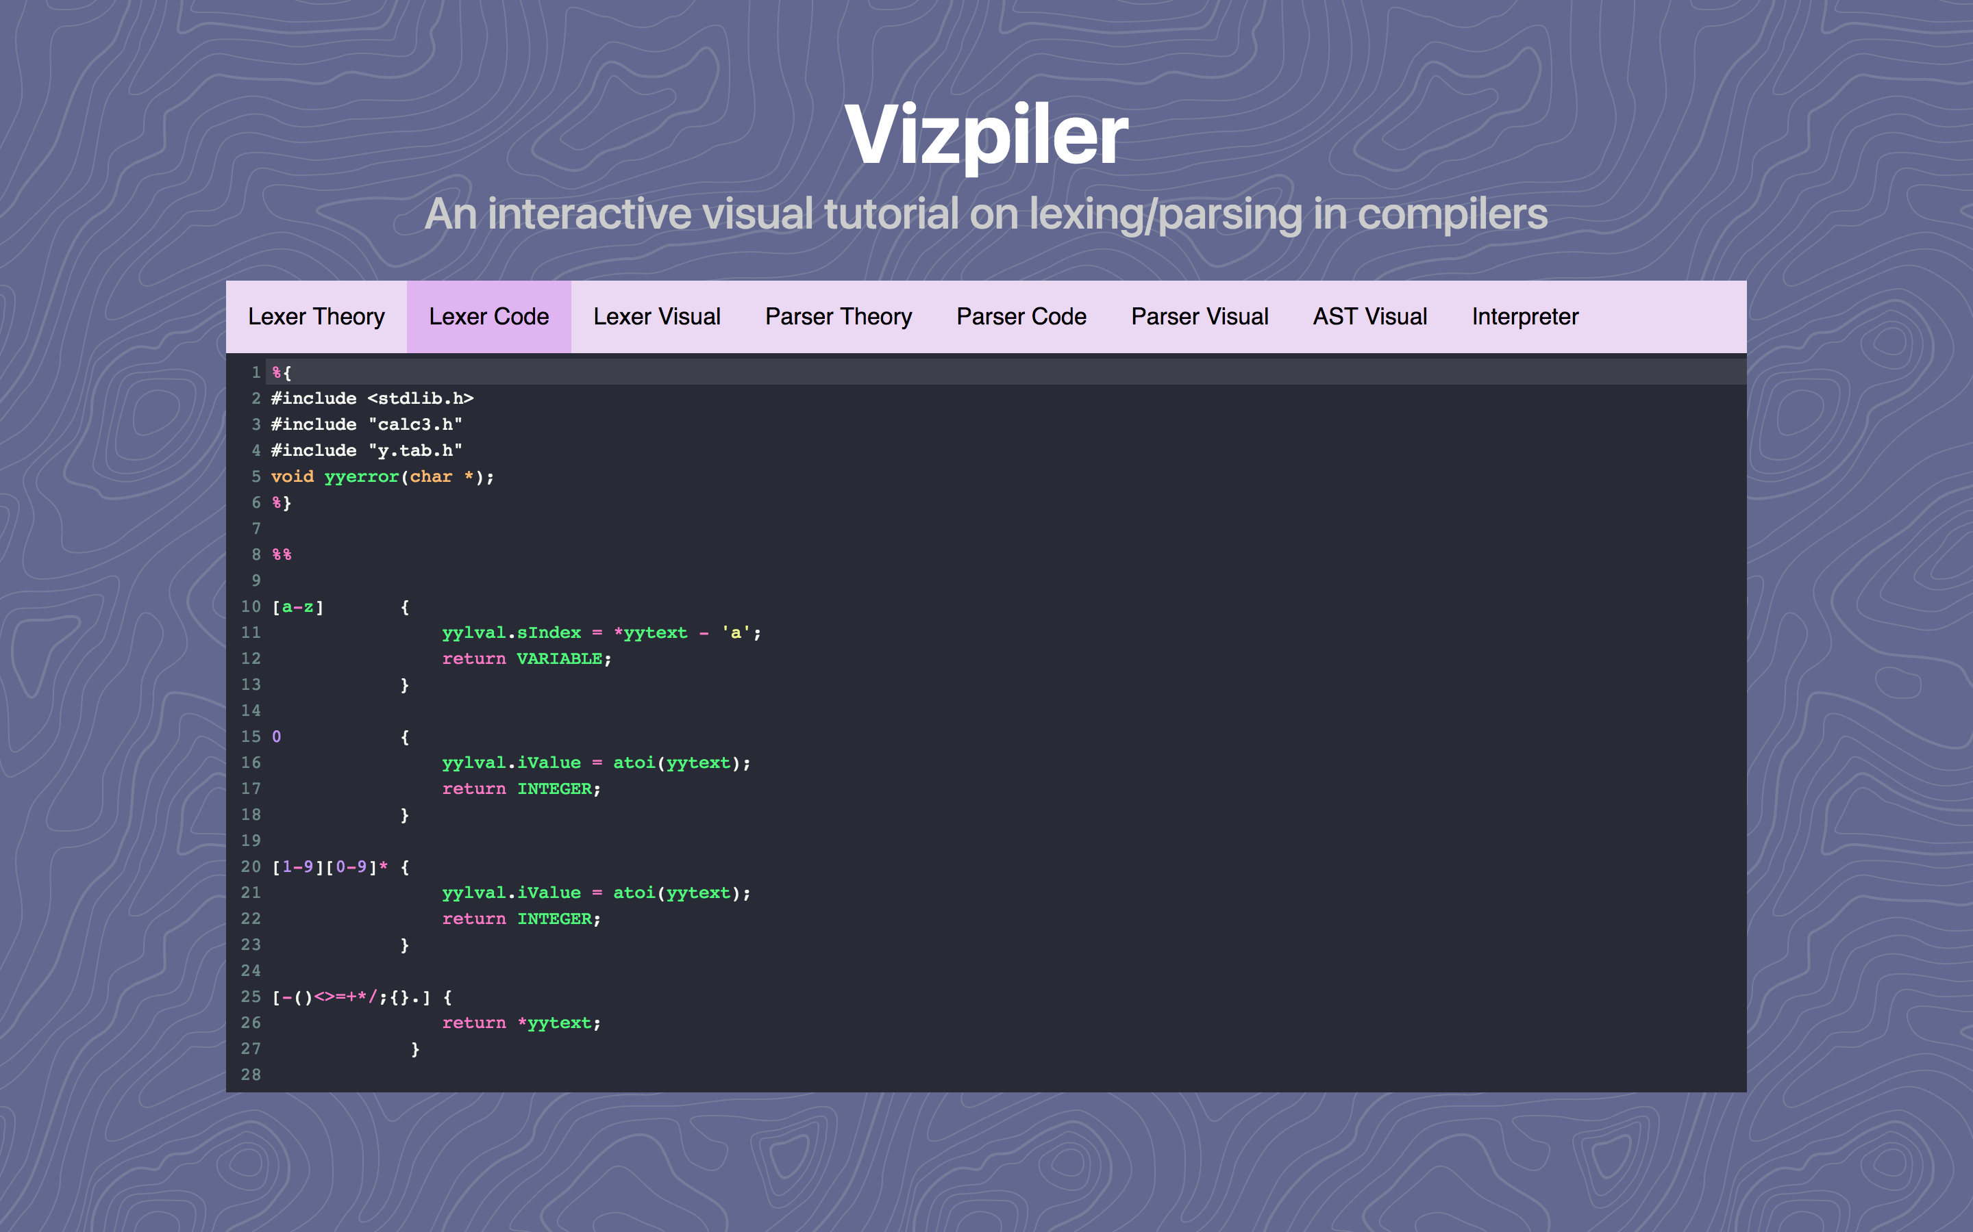
To see the prototype (that doesn’t do anything yet): goo.gl/2342jkndflk

Slide 2
What is Vizpiler?
Interactive tool for visualizing how compilers work
Three sections for each part:
Theory
Code
Visualization
Steps in a compiler:
Lexical analysis (also called lexing)
Parsing and Abstract Syntax Tree (AST) generation
Code generation (not covered in Vizpiler, instead we have an interpreter)

Slide 3
Lexing
Reading a sequence of characters and determining what tokens are being expressed
Example¹: foo = 1– 3**2
Lexeme | Token Type
foo | Variable
= | Assignment Operator
1 | Number
- | Subtraction Operator
3 | Number
** | Power Operator
2 | Number
1. From https://www.cs.wmich.edu/~bhardin/cs4850/flexbison.pdf

Slide 4
Lexing
How does it work? What’s the algorithm?
Based on converting regular expressions to a combined DFA
There is an open-source tool called flex that does this for us

Slide 6
Parsing
Reading a sequence of tokens and building a tree of how they should be recursively be interpreted
Interpretation is called a “grammar”
Can be expressed in “Backus-Naur form” or BNF
Simple BNF example for mathematical expression (see recursion!)
<exp> ::= <exp> + <exp>
<exp> ::= <exp> - <exp>
<exp> ::= <exp> * <exp>
<exp> ::= <exp> / <exp>
<exp> ::= <number>

Slide 7
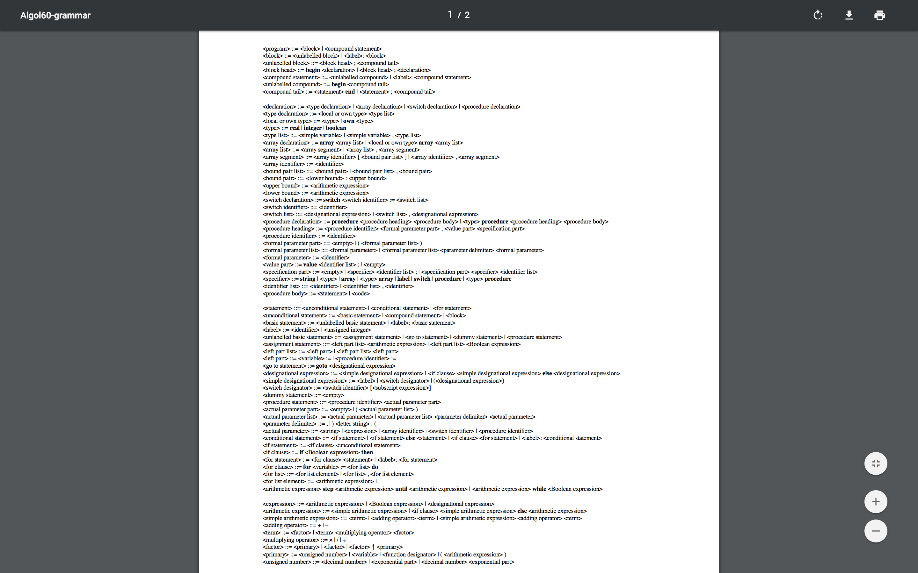
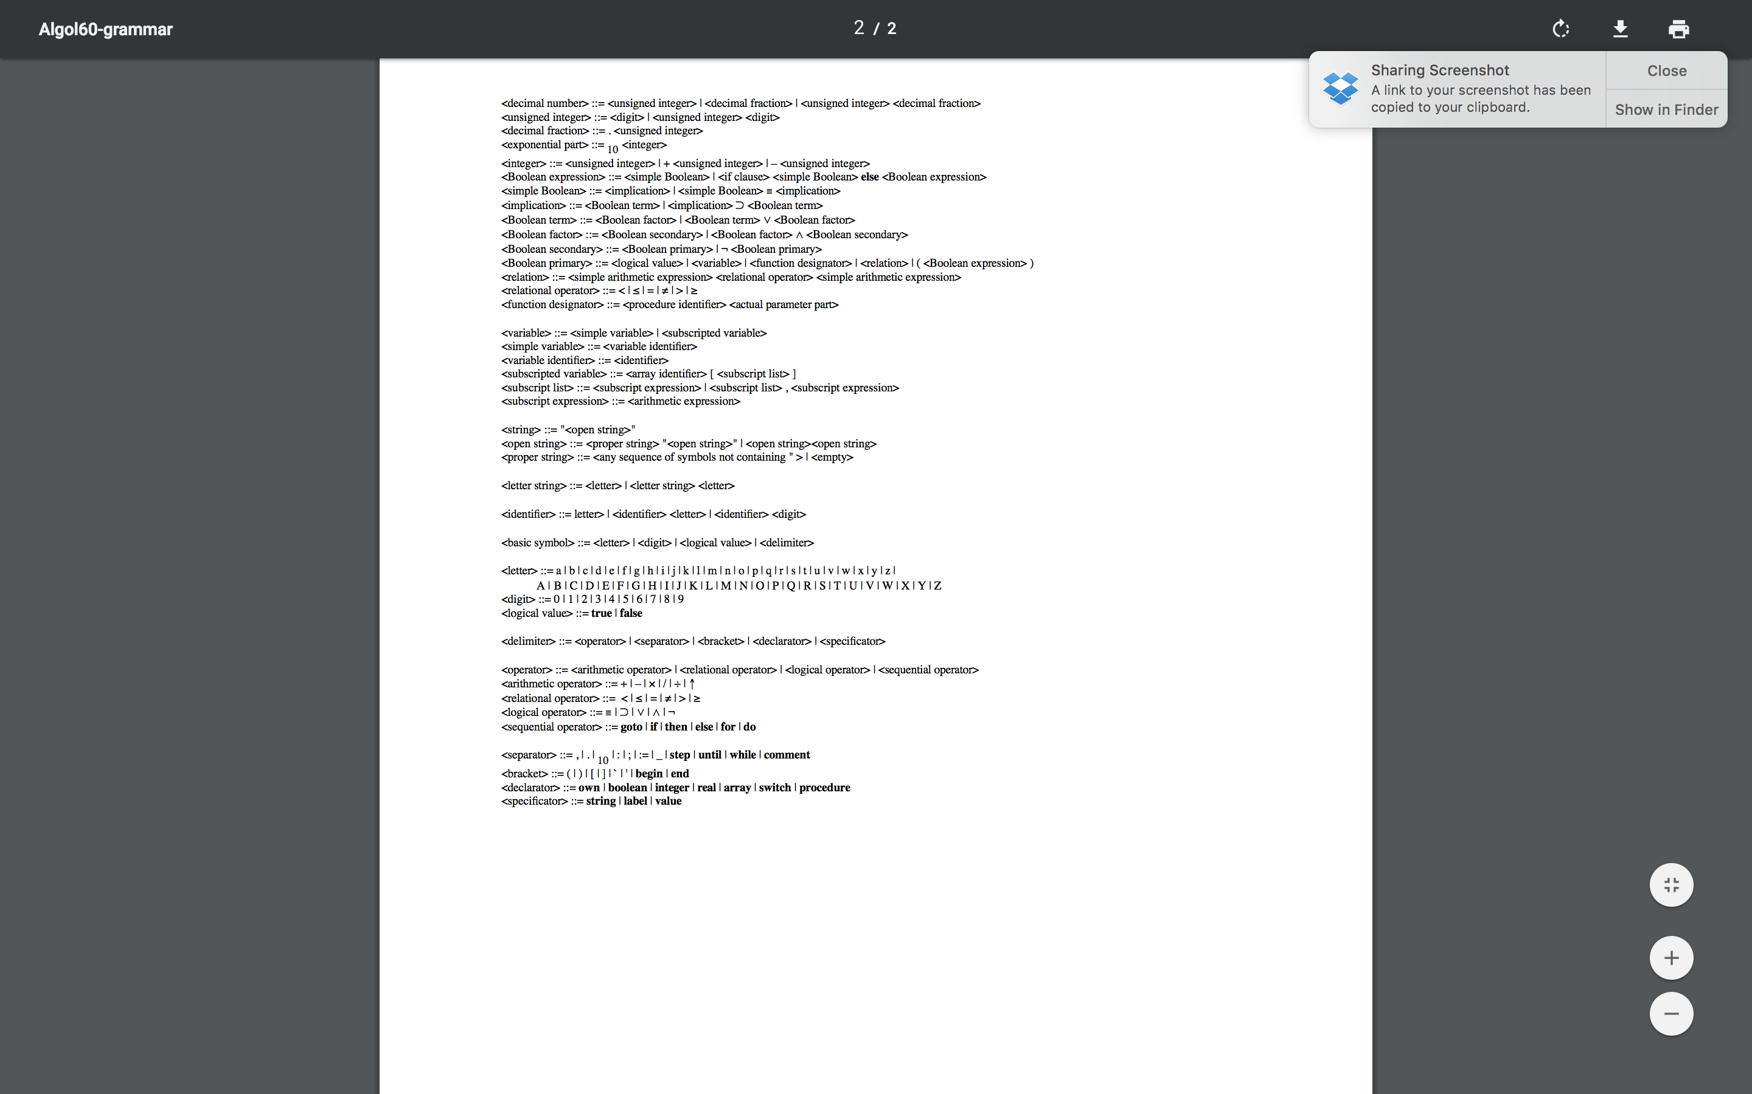
Algol-60 BNF
Can get very involved!

Slide 8
Parsing
How does it work? What’s the algorithm?
More complicated than lexing
Also uses a DFA, but the states and transitions are determined by LR(1) parsing algorithm
See my tutorial when it’s complete for more info if you’re interested!!! (I will post it on the Piazza page) ☺
The parser parses the expression into an Abstract Syntax Tree (AST) which can be used for code generation

Slide 11
What VP does
Allows you to learn about and build a programming language in-browser
Code is sent to Node.js server and compiled (am working on this currently)
FSM diagrams are returned to user for visualization!
If I have enough time/interest, I will add one or more of the following features:
Visualize the AST
Step through the FSM states
Sandbox the compilation process on the server/create access control to make sure server resources are not abused
Permanently host the server somewhere (AWS)

